Slide 1
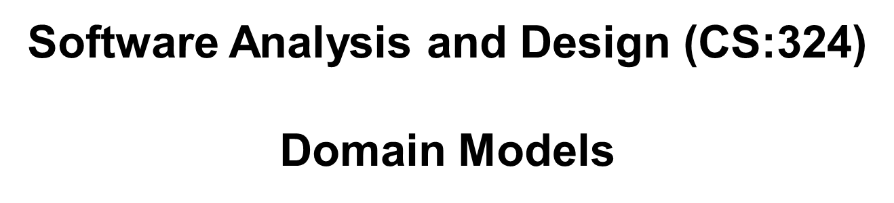
Drawing System Sequence Diagrams(SSD)
Applying UML and Patterns
Craig Larman

Slide 2
System Sequence Diagrams (SSDs)
SSD is an artifact of analysis that illustrates input and output events related to the system.

Slide 3
SSDs and System Behavior
System behaves as “Black Box”.
Interior objects are not shown, as they would be on a Sequence Diagram.
:System

Slide 4
Use Cases are Source for SSD
Use cases describe
How actors interact with system.
Typical course of events that external actors generate and
The order of the events.

Slide 5
SSD Components
For a particular scenario of use-case an SSD shows-
The external actors that interact directly with the system.
The System (as a black box).
The system events that the actors generate.

Slide 6
What SSDs Show
Match operations of the system in response to the events generated
Depict the temporal order of the events.
Should be done for the main success scenario of the use-case
Also for frequent and alternative scenarios

Slide 7
Objects on SSDs
Objects are instances of classes.
Represented as a rectangle which contains the name of the object underlined
Because the system is instantiated, it is shown as an object.
:Object1

Slide 8
Actors on SSDs
Actor: An Actor is modeled using the ubiquitous symbol, the stick figure.
actor1

Slide 9
Lifelines on SSDs
LifeLine identifies the existence of the object over time. The notation for a Lifeline is a vertical dotted line extending from an object.

Slide 10
Messages on SSDs
Messages, modeled as horizontal arrows between Activations, indicate the communications between objects.
messageName(argument)

Slide 11
Example of an SSD
Following example shows the success scenario of the Process Sale use case.
Events generated by cashier (actor)-
makeNewSale
enterItem
endSale
makePayment.

Slide 12
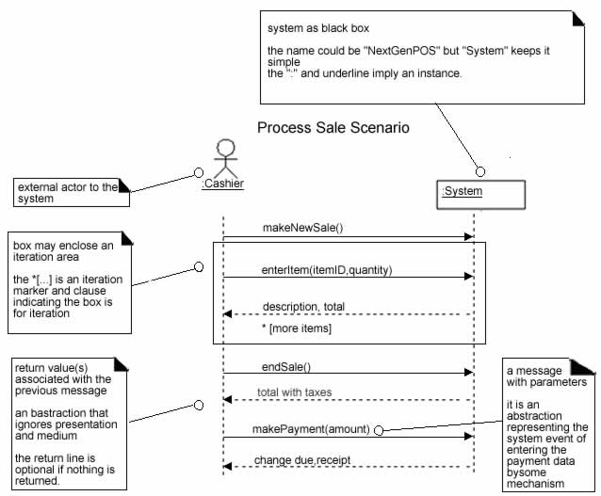
SSD for Process Sale scenario

Slide 13
Create SSDs for each Use Case
Draw a lifeline representing the system as a black box.
Identify each actor that directly operates on the system. Draw a lifeline for each actor
From the use case happy path text, identify system (external) events that actors generate (look at right side of the flow of events). Add them as messages to diagram.
Add the main outputs from the use case as messages back to actor – see use case table
Optionally, include the use case text to the left of the diagram.

Slide 14
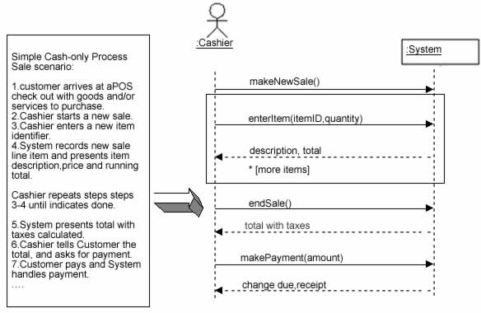
SSDs are derived from use cases.

Slide 15
Naming System Events and Operations
System event
External input event generated by an actor.
Initiates a responding operation by system.
In order to improve the clarity, it is appropriate to start the name of the system event with a verb
System operation
Operation invoked in response to system event.

Slide 16
Choosing SSD event / operation names
“enterItem” is better than “scan” as it captures the intent of operation rather than what interface is used to capture the system event (design choice).

Slide 17
SSDs in Analysis
SSDs are a visualization of the interactions implied in the use cases.
It is useful to create SSDs during analysis to:
Identify the system events and major operations
Write system operation contracts (Contracts describe detailed system behavior)
Provide a way for us to visually step through invocation of the operations in Use-Cases.

